Slide 1
CS2001 YEAR2 Group 15 app designs & research
INITIALLY BY EDZEL MONTEVERDE
Feel free to add to this powerpoint

Slide 2
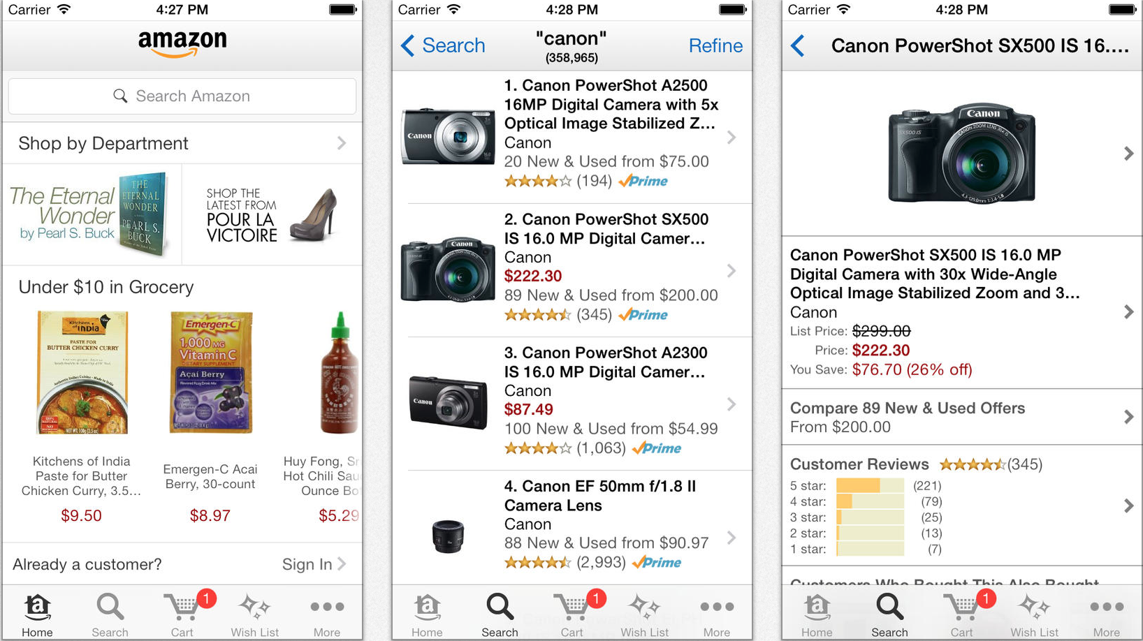
Analysing Shopping app designs – Amazon IOS
Search Screen:
A list of available items related to the user’s search which is shown at the top.
Pictures remain small to fit as many items as possible.
Only name and price, as well as review are shown as details which is what the user usually looks at first hand before clicking on the product.
Item Info Screen:
Enlarged photo of the image. Photo of image is standardized to have white background in order to be more attractive.
Text overwhelms images, where text involves details about the product.
More important features go at the top and in larger font. E.g. Price.
Home Screen:
Immediately provides links to more popular products.
Provides only several buttons to navigate the app for the sake of simplicity.
Images overwhelm the text when the intent of the page is to get user to ‘start’ shopping.

Slide 3
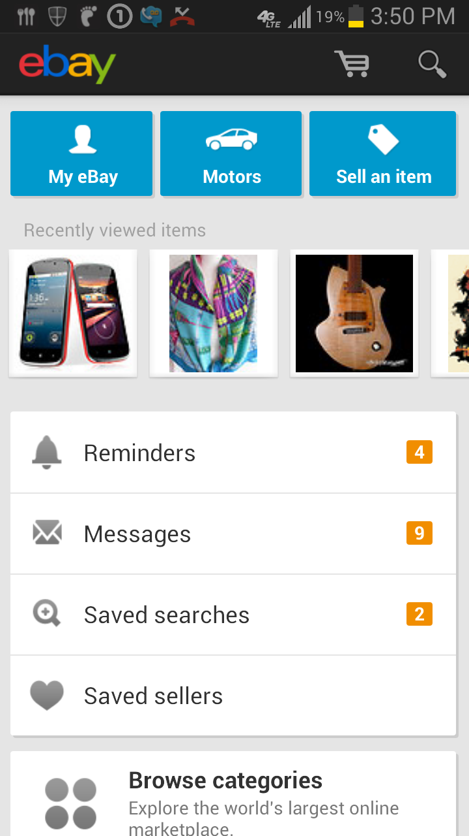
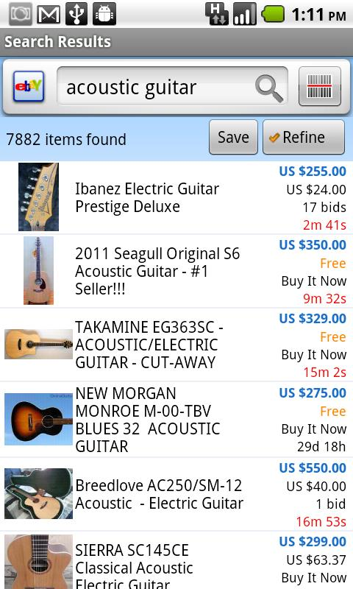
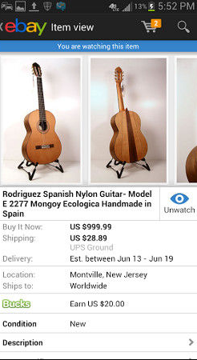
Analysing SHOPPING app designs – EBAY Android
Search Screen:
A list of available items based on the user’s search.
Search bar is directly on the screen to make re-searching easier.
Similar to the amazon app, text overwhelms the images but item details are much more structured compared to the amazon app (Less cluttered)
Item Info Screen
Enlarged photo of the image. Photo of image is not standardized to have white background. Entirely up to vendor.
Text overwhelms images, where text involves details about the product.
Multiple images of product shown in a ‘swipeable’ layout.
Home Screen:
More colourful interface to make sense of the UI much more easily.
Features which user may need to access upon opening the app overwhelm most of the screen. E.g. Messages, reminders and ‘my ebay’ which is presumably their account details.

Slide 4
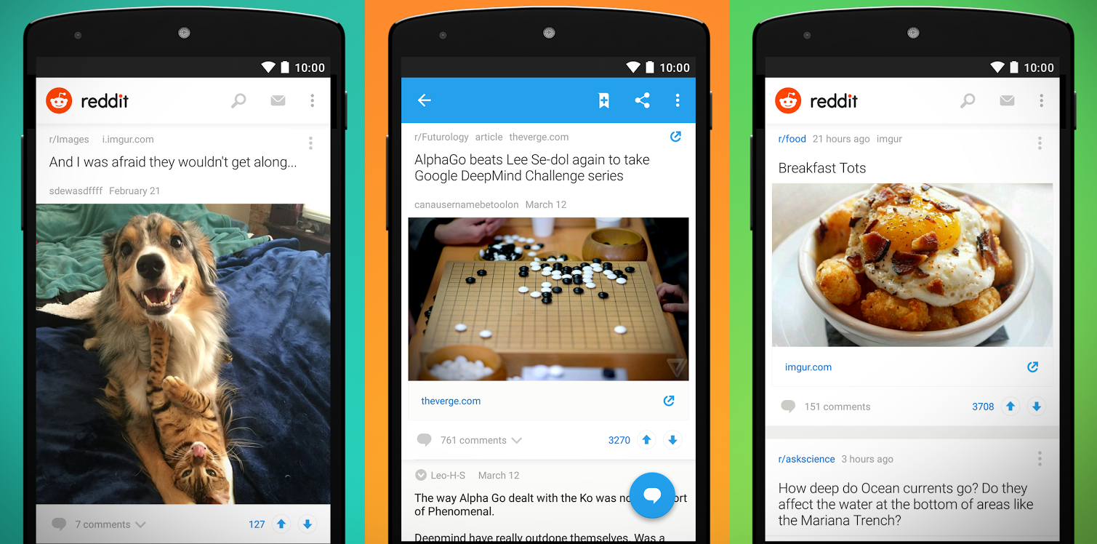
Analysing other app designs – Reddit Android
Comments Screen:
Text complements the visual style of the app.
More important information at the top of the app.
There are certain buttons which ‘hover’ while the user swipes. Allows easy access to the button, and prevents the need to swipe back to the top of the page to access it.
Home Screen:
Clean interface to suit the taste of certain users.
Images overwhelm the text. However the effect of this on the user largely depends on the quality of the images posted.
Clear to user what they need to do to navigate the app, i.e. swipe and tap.

Slide 5
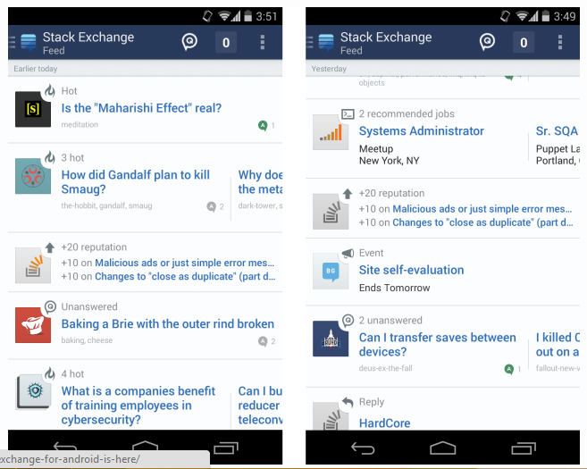
Analysing other app designs – STACK EXCHANGE andr
Home Screen:
Clean interface, where text is more present than the images.
However, manages to keep the interface neat and tidy.
Images are provided only by the app and not by the user.
Tags items on the list with ‘hot’ or ‘Event’ in order to make discerning items easier.
Action bar displays the section the user is in. I.e. ‘Stack Exchange – Feed’, It could also be ‘Stack Overflow – Feed’.
Only buttons which are going to be accessed the most by the user are present in the action bar. Other less used features are placed in the drop-down menu.

Slide 6
Summary OF FINDINGS
Most user interface from those apps had some colour, 1-3 shades. Not too much or too little. Which helps discerning some buttons/features, should the interface become too cluttered.
Depending on the functionality of the screen, the most important buttons/features are shown. E.g. For a search result list: The price, image and rating of the product are among the first to show up.
The user interface of an app depends on the end user, and the purpose of the app. As a result there could be an option to change the user interface for the app based on the user.
Action bars hold other functions the user needs, but not at the current moment.
Each screen is designed to only have one function: The selling screen only shows features that may entice the user to purchase an item, e.g. Big pictures, Suggestions etc…

Slide 7


BRUNEL APP - THE LOGIN SCREEN
Emphasize a clean interface.
Immediately shows who the app is designed for by using the university logo, giving the user a hint to know what details the app will ask for to log in successfully.
No need for a ‘Sign up button’ since you can’t sign up to the university in that way. Obviously if we’re not using Brunel logins, then we can probably put a ‘sign up’ button.
All features of the app in the centre: Referencing the usability engineering lecture on Gestalt principles. As a result they are assumed by the user to be directly related.
Use only 1-3 colours, and makes it clear what the buttons/textboxes are for.
Welcome to the student shopping app!
Student number or network username
Network Password

Slide 8







Buyer
Seller
Buyer
Seller
1234567@my.brunel.ac.uk
1234567@my.brunel.ac.uk
Messages
Messages
My items
Settings
Sell an item
Items sold
Both interfaces show what the user will see if the select the user icon. The one who is selling can see if they have received any messages from anyone who is interested in their items, if they would like to buy an item and how many items were sold. The bar on both of the sections have been greyed out to show that the buyer/seller has already selected this item.
Settings

Slide 9

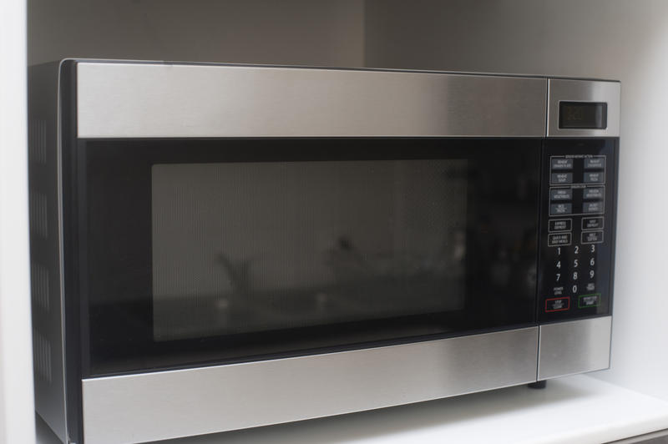
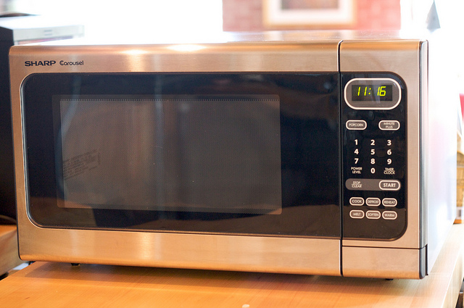
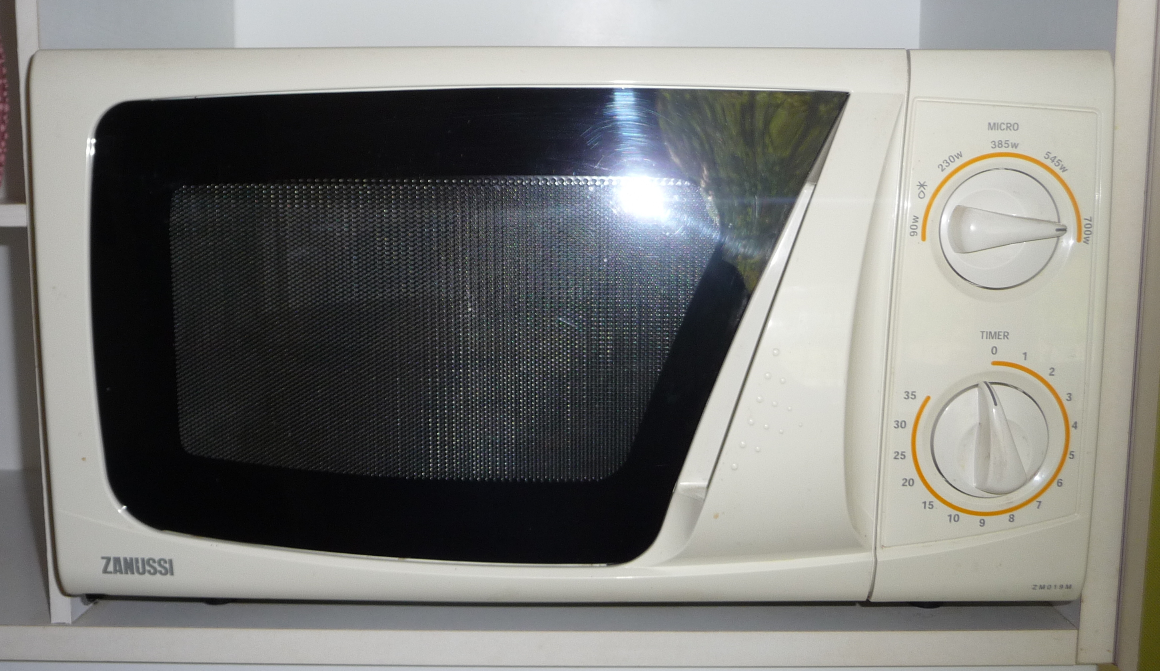
Results on: Microwave
Used microwave for sale
£50
£50
*Information about the product here*
Microwave for sale used for a year only
If the user selects the product they can find more information about the product
£25
Quality rating:
Contact seller
Microwave for

Slide 10
Categories
Home Page
By clicking the icon bar, it allows the user to look at items in categories rather than to search them or have many items appear on the page.
Electronics
Once the user clicks on the icon, it shows a few of the listen categories. How to determine where each item goes in which category, the seller can tag key words to the item so it is easier to search for the item and determine which category it can go into by using key words.
Clothes
Books
Outdoors
Other

Slide 11
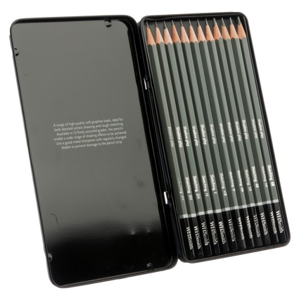

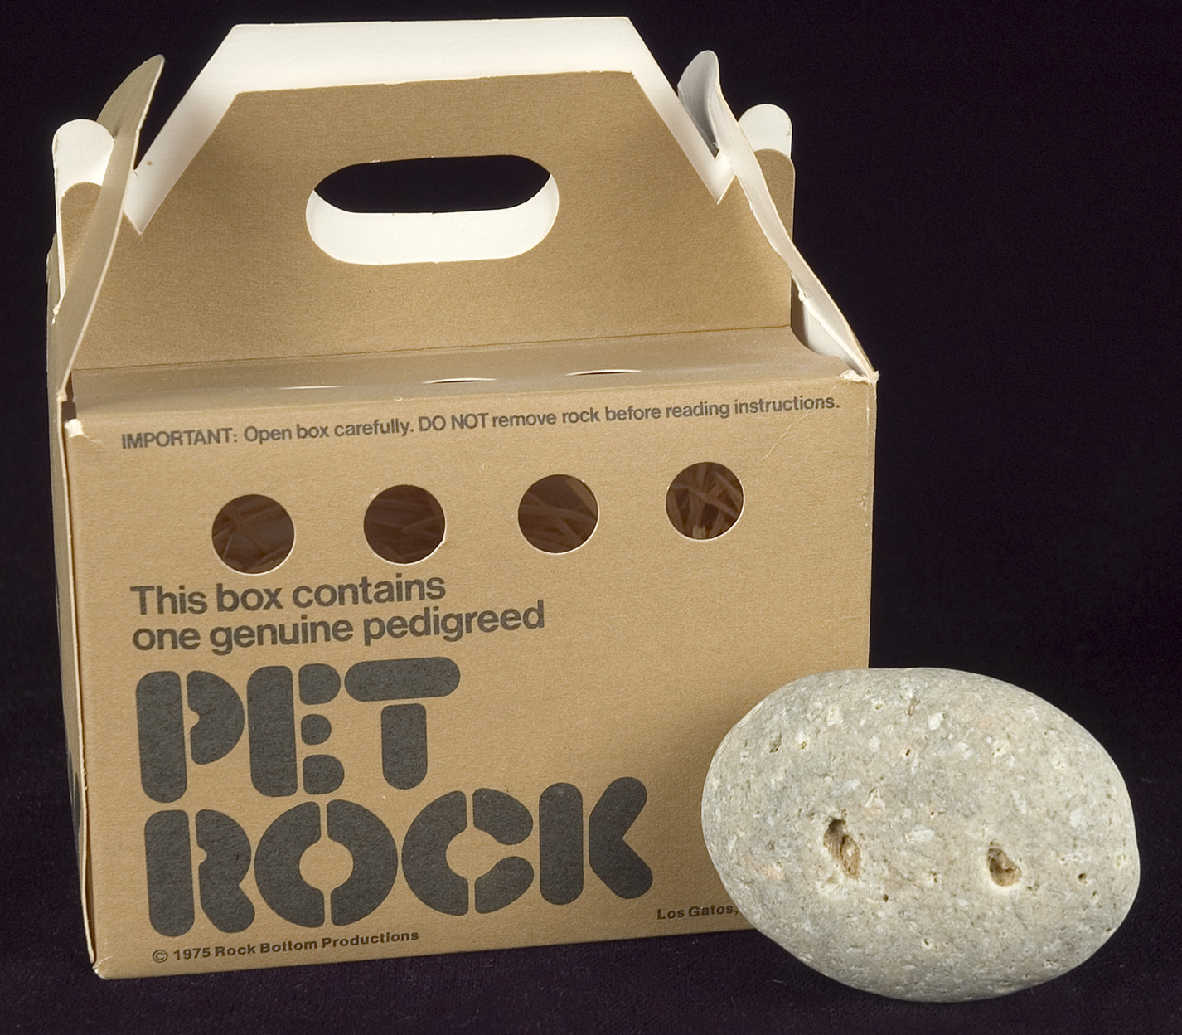

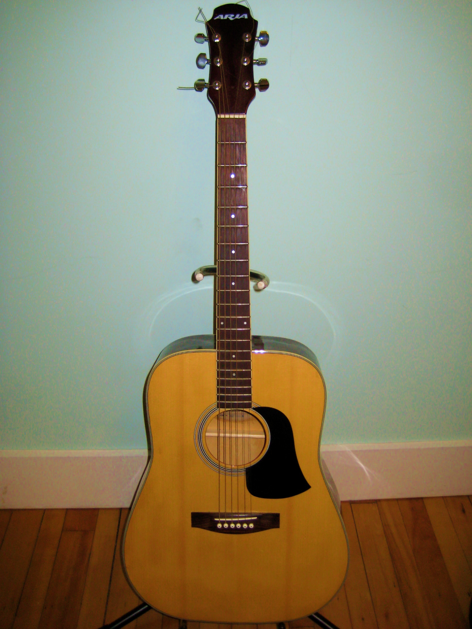
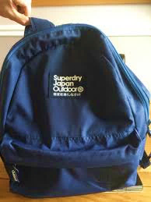
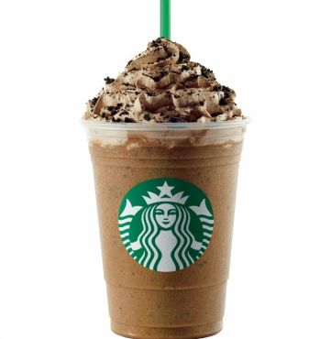
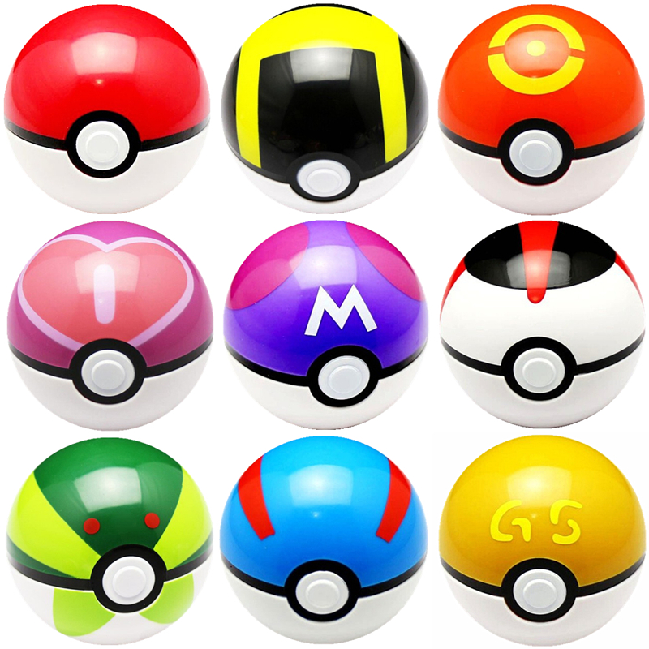
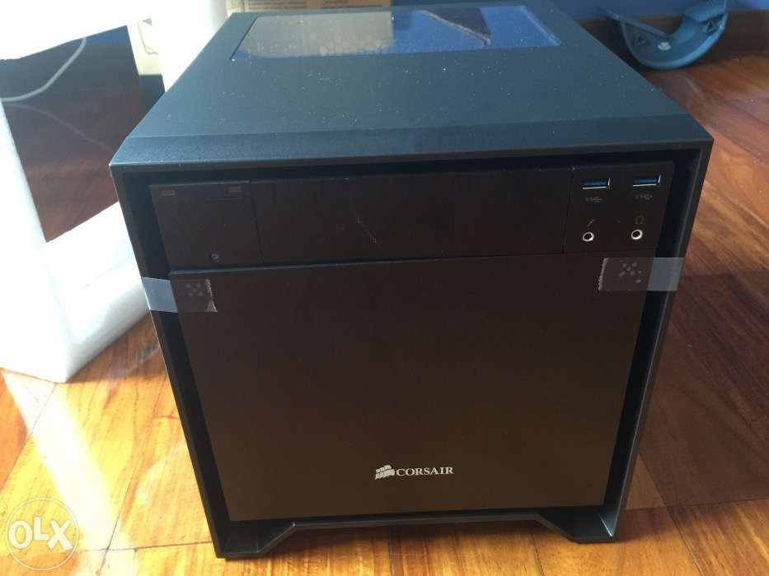
BRUNEL APP - THE HOME SCREEN
Welcome to Brunel Sell: Student 1234567!
Provide large images and clickable links to items the user may be interested in. User can swipe easily to select certain items.
Make a search bar button and a basket icon available at the user’s disposal.
Clear, visible buttons at the bottom for account based functions (What the user might like to do when they first open the app.)
Menu on the action bar which may lead to other important but less relevant functions.
Most colours are contrasting to capture the user’s attention.
User’s previous search used for analytics.
Trending:
Suggestions for: ‘Pokémon’ ‘Hungry’ ‘Guitar’
My Shop
2
My Orders
5
My Messages
0
My Account

Slide 12
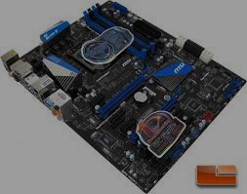


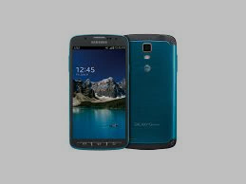

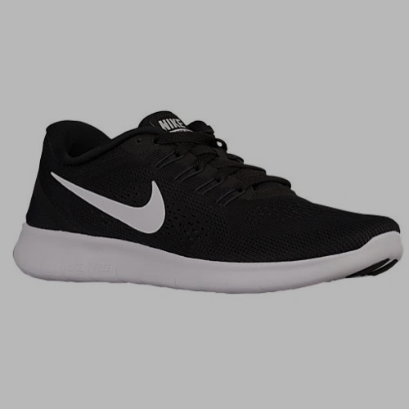
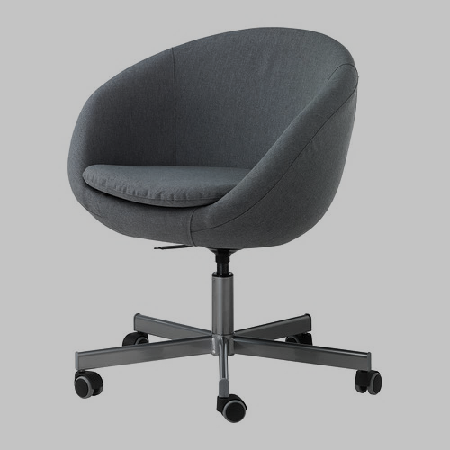
BRUNEL APP - THE SEARCH SCREEN
142 Results for: ‘Free’ ‘Stuff’ ‘Give’ ‘Me’
Smaller images, more text.
Include key information about the items such as name, price, image and rating.
Keep images and information short so user can easily compare which items are better, and so more items can fit on the same screen.
Menu on the action bar which may lead to other important but less relevant functions.
Avoiding too much contrast on the text/images to make UI easy on the eye.
Search result number, and search query noted for user’s reference. Can be clicked on to re-search items.
MSI Motherboard (Used Good Condition)
£57.99
Seller Rating:
Logitech 270I Mouse (Used 1-Year)
£5.99
Seller Rating:
Samsung S4 (4-Years Old)
£87.00
Seller Rating:
An Introduction To SQL (Newly Bought)
£21.99
Seller Rating:
Nike Helium Trainers (Newly Bought)
£51.99
Seller Rating:
Swivel Chair (7200 RPM, 1-Year of use)
£17.99
Seller Rating:

Slide 13
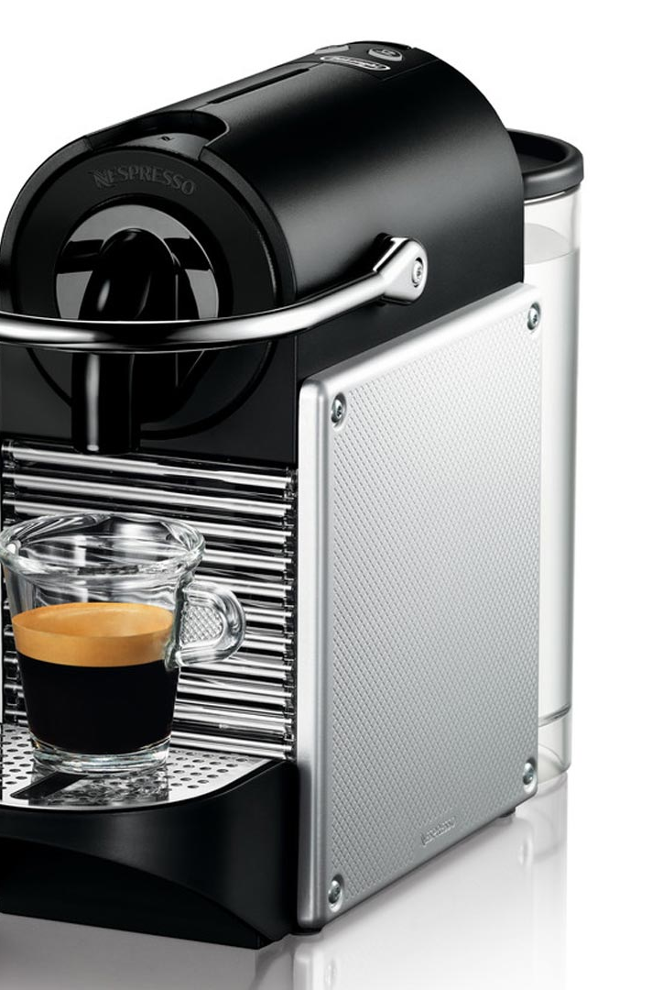
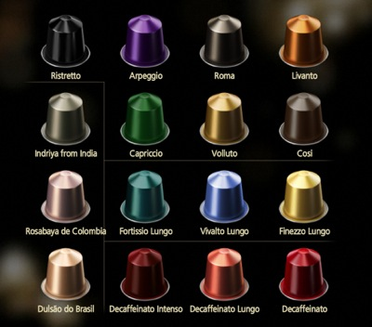
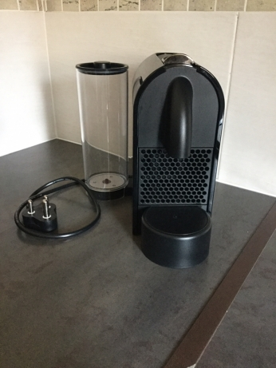
BRUNEL APP - THE ITEM SCREEN
Back
Nespresso Coffee (Used, 1-Year Old)
Swipe to view images. Tap to enlarge image.
Buttons for going back to result list, or for sending messages, while being clear to see.
Item info includes vendor details, item description, collection details and price, as well as the option to look at reviews.
Can send vendor private messages which involve fixed phrases such as: ‘I would like to’ ‘reduce the price’ ‘deal’ to avoid profanity and illegal vending.
Customer reviews on the vendor.
Can send purchase notification which means a deal has been agreed with.
Pre-owned coffee machine.
Fully functional, missing hot water and coffee beans
Negotiable price, pm me for details.
Was: £58.22
Now: £57.99
You save: £0.23
Seller Rating (Past week):
Send Message
Collection Details: Time remaining (2 days)
Building: HALB 223
Time: 2:30PM
Date: 10.2.17
Send purchase notification
Customer Reviews On Student 1111111…

Slide 14
BRUNEL APP - THE Message SCREEN
Back
Speaking To Student: 1234567
Click here to print this conversation…
I am selling for £34.14
12:12pm
Only select messages can be used on the messaging screen. This can avoid profanity and can keep conversations strictly to price/location negotiating.
Conversations are stored on chat server for future reference and printability.
Student number speaking to is displayed on the top
This enables convenient conversation to occur to ensure both sides of the transaction are satisfied.
12:45pm
I would like to raise the price
How much By?
12:59pm
01:19pm
To £54.99
Deal
01:20pm
Your message:
Let’s meet up + By
Deal
How much by?
No thanks
Let’s meet up
Today
Tomorrow
I would like to raise the price
By
At
Select Location…
Numerical Value…

